Slide 1



Slide 2


University Institute of Technology, RGPV
MCA 4TH SEMESTER
PERFECT 15
Machine Learning-based Player Performance Predictor for IPL
Satyendra Kumar Namdeo
(0101CA231056)

Slide 3


INTRODUCTION
Super 15 is a smart, AI-powered platform designed to help users predict top performing players in IPL matches.
It analyzes player statistics, performance trends, and match conditions.
Helps users optimize fantasy league picks or coaching strategies.
Delivers fast, reliable insights with visually appealing analytics.

Slide 4










OBJECTIVE
Predict 12 core players and 4 backup players most likely to excel based on:
Previous Match Performance: Analyze runs, wickets, strike rates, economy, and player impact.
Venue-Specific Data: Performance of players at different grounds and under varying conditions.
Role-Based Optimization: Ensure a balanced team with batsmen, bowlers, all-rounders, and wicketkeepers.
Player Form & Consistency: Track recent match performances to highlight consistently performing players.
End Goal:
Help analysts, fantasy league players, and coaches build optimized, performance-driven teams.
Provide data-driven player recommendations with a tactical edge.

Slide 5


PROBLEM STATEMENT
Manual selection issues:
Time-consuming
Data-overload
Prone to human bias and oversight
IPL context:
Frequent matches, dynamic team compositions
Inconsistent player performance depending on opponent/venue
Need a scalable, data-driven solution to simplify selection.

Slide 6



DATASET INFORMATION
Sources: Kaggle + custom ongoing match tracking
Data Range: IPL 2022 to IPL 2025 (current)
Files Used:
Ipl_deliveries.csv – Ball by ball Details.
Ipl_2025_team_players.csv – Roles and Team mapping
Data Preprocessing:
Null handling, player name normalization, performance aggregation
Key Columns:
Season
Venue
Striker
Bowler
runs_of_bat
wicket_type
Team, etc

Slide 7
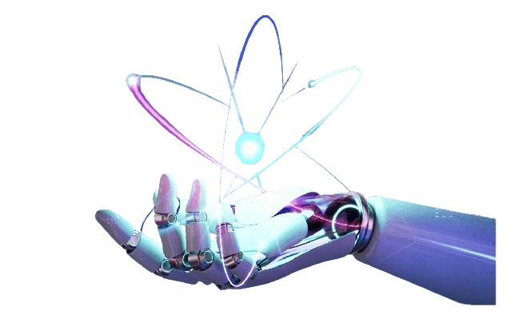
ML MODEL & TECHNIQUES
Algorithm: Random Forest Classifiers
Why Random Forest ?
Handles non-linear relationships well
Reduce overfitting
High accuracy on structured tabular data
Features Used:
Players Performance on the basis of their past matches.
Players Category wise performance.
Applying algorithm to predict player performance.

Slide 8
SYSTEM ARCHITECTURE OVERVIEW
User UI
Frontend(HTML/JS)
Flask Backend
ML Prediction
Output

Slide 9
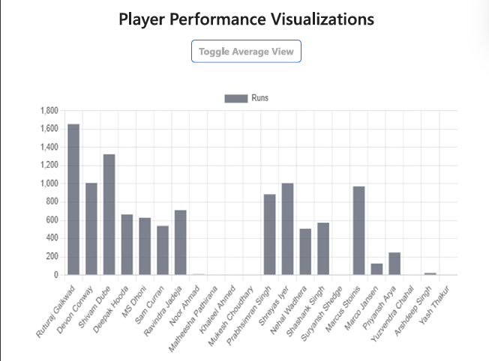
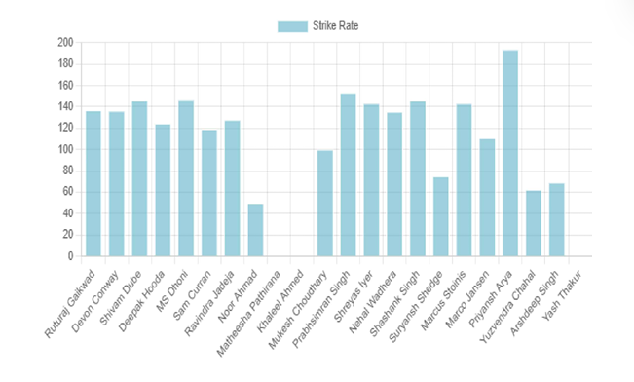
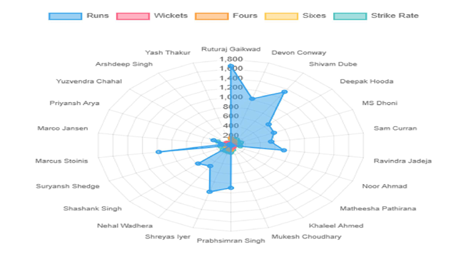
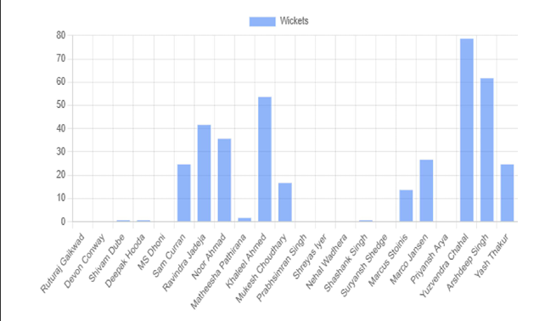
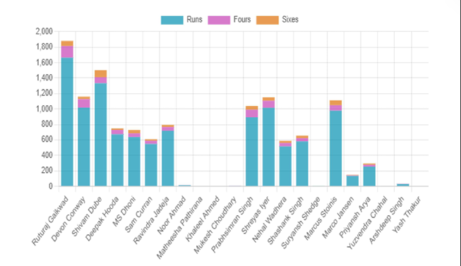
VISUALIZATION & CHARTS

Slide 10
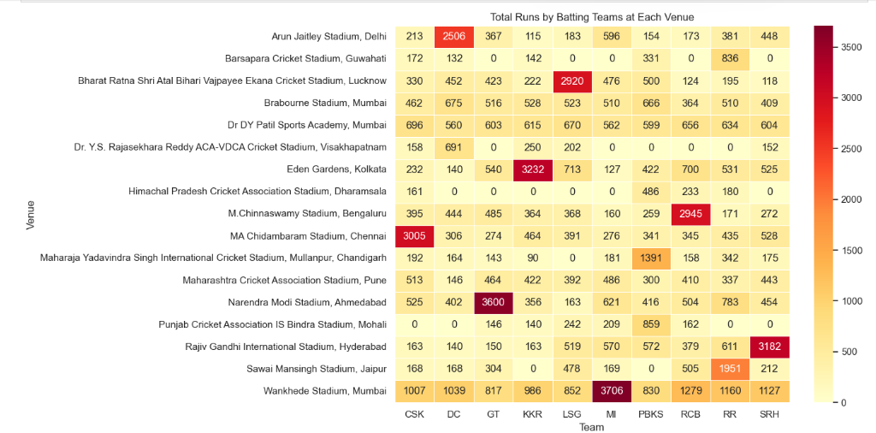
VISUALIZATION & CHARTS

Slide 11
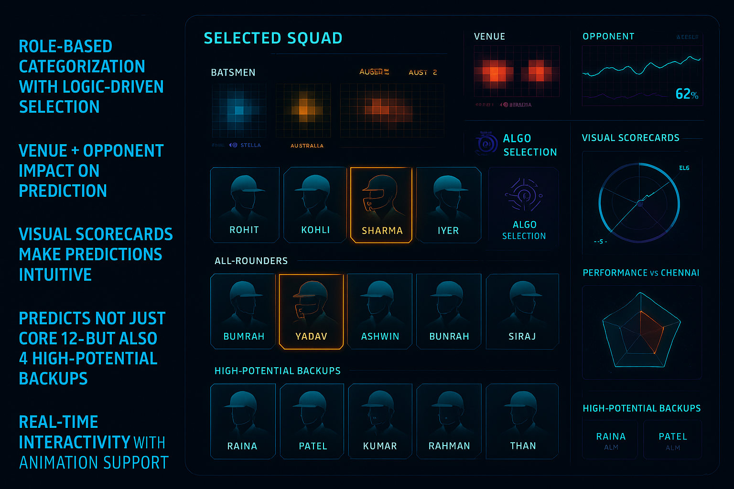
INNOVATIONS & KEY DIFFERENTIATORS

Slide 12

CONCLUSION & FUTURE SCOPE
Conclusion:
Super 15 empowers users to make smart, data-backed decisions
Reduces time and increases confidence in team building
Future Scope:
Live match API integration
Real-time form and injury monitoring
Mobile app version
Enhanced model (XGBoost, Deep Learning)

Slide 13


